Slide 1

Market Potential
Index (MPI)
Assessment
Prepared by:
Vanshika Arora
Date: 13TH November 2025
Market Expansion Strategy
– Indian Cities Analysis

Slide 2
Objective
Objective:
  Identify high-potential cities in India for market expansion.
  Use Market Potential Index (MPI) to rank cities based on key metrics.
Outcome: Prioritize cities with the highest potential for investment and growth.

Slide 3

Data & Methodology
Data Sources: [World Bank Open Data, Kaggle Datasets [Statista] (for reference values), IMF Data
Metrics Used for MPI:
  Population & urbanization
  Average income & purchasing power
  Market size & growth trends
Methodology:
  Normalized each metric for comparability
  Weighted metrics based on importance
  Calculated MPI score for each city
Tools: Power BI, Excel
AI Tools: Chatgpt, Perplexity

Slide 4
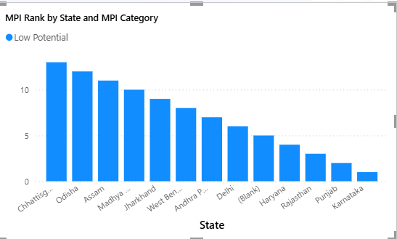
Market Potential Index (MPI)
Top Cities by MPI Score:
MPI Categories: High, Medium, Low potential
Insight: Cities with higher MPI scores are prime targets for market expansion.

Slide 5
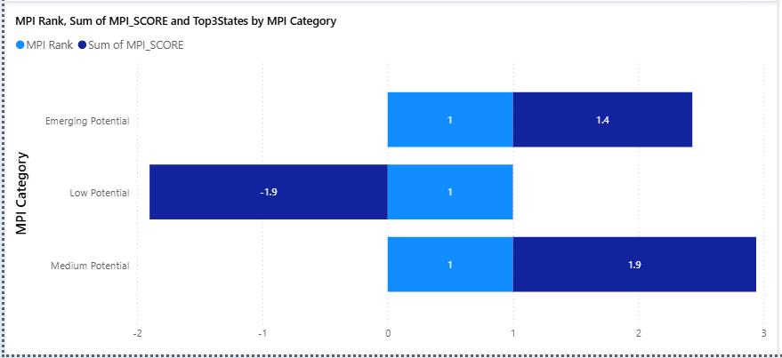
Top Cities for Expansion
Key Points:
Metro cities dominate the top ranks due to higher income and urbanization.
Tier-2 cities show emerging potential, suitable for phased expansion.
Focused strategies in high-MPI cities can maximize ROI.

Slide 6
Key Insights
Insights:
Regions with untapped potential identified for strategic investment.
Top 3–5 cities present the highest short-term growth opportunities.
Some high-population cities have lower MPI due to saturation or lower purchasing power.
MPI provides a quantifiable measure to guide expansion decisions.

Slide 7
Recommendations
Immediate Actions:
Prioritize top 5 cities for entry and initial marketing campaigns.
Plan phased expansion in Tier-2 cities to capture emerging markets.
Allocate resources based on MPI category and market potential.
Strategic Focus:
Focus on high-MPI cities for maximum impact.
Monitor Tier-2 cities for long-term growth opportunities.

Slide 8
Conclusion
Summary:
MPI analysis highlights the most promising cities for market expansion.
Metro and high-income cities lead in potential; Tier-2 cities show emerging opportunities.
Recommendations offer a phased, data-driven approach to expansion strategy.
Call to Action: Implement expansion in high-MPI cities while monitoring Tier-2 growth trends.

